Slide 1

Sprocket Central Pvt Ltd
Data analytics approach

Slide 2
Agenda
Introduction
Data Exploration
Model Development
Interpretation

Slide 3
Introduction
This is a project for the KPMG Data Analytics Virtual internship. Here is a little background of the task:
Outline of Problem
Customer Demographic: this includes names, date of birth, gender, job title, job industry category and wealth segment of the customers.
Customer Addresses: this gives the postcode, street and state for each customer.
Transactions data: consists of the product id, transaction id, brands, product size, standard cost and list price.
New customer list: this is for new customers who have not done any transaction with the company.
Contents of Data Analysis
Total profits by gender
Total profits by wealth segment
Total profit by job industry
Total Profit by State
Quantity sold per brand
Revenue trend by month
This will be done with the three phases of:
Data Exploration,
Model Development, &
Interpretation.

Slide 4
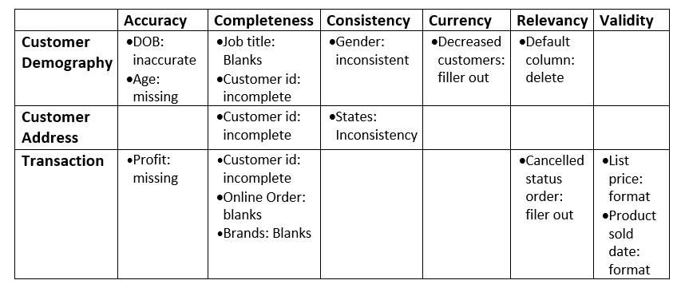
Data Exploration
Data Quality Assessment and Clean up
Key Issues for Data Quality Assessment
Accuracy: Correct Values
Completeness: Data Fields with Values.
Consistency: Values Free from Contradiction
Currency: Values up to Date
Relevancy: Data items with Value Meta-data
Validity: Data Containing Allowable Values
Uniqueness: Records that are Duplicated
An in-depth analysis has been sent via email.
Summary Table

Slide 5
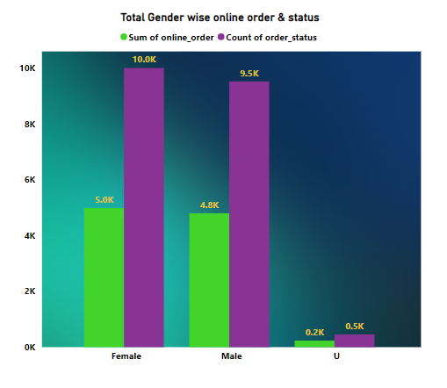
Data Exploration
Total profits by age group and gender
The middle aged group
(40 to 59 years) and
the young (20 to 39 years) generated more profit to the company with almost equal number of male and female customers.

Slide 6
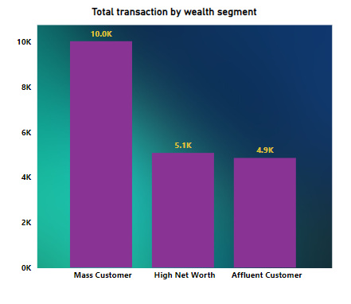
Data Exploration
Total profits by wealth segment
The mass customer wealth segments had the highest profit for the total Transaction by wealth segment

Slide 7
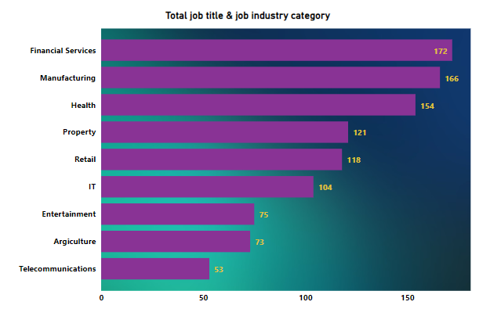
Data Exploration
Total profit by job industry
Those in the manufacturing and financial services job sector had the highest profit.

Slide 8
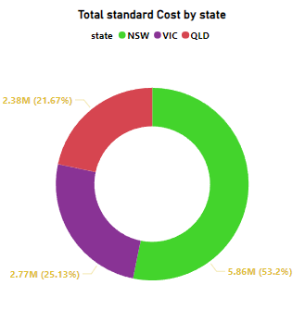
Data Exploration
Total Profit by States
In all age categories the largest number of customers are classified New South Wales (NSW) had the highest profit of $ 5.86 M which is 53.2% of the total profit for the year.
The next category is the High Net Worth' customers.

Slide 9
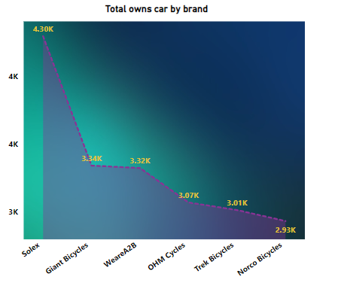
Data Exploration
Quantity sold per brand
Solex is the most sold popular and sold brand for the year followed by giant bicycles and WeareA2B.

Slide 10
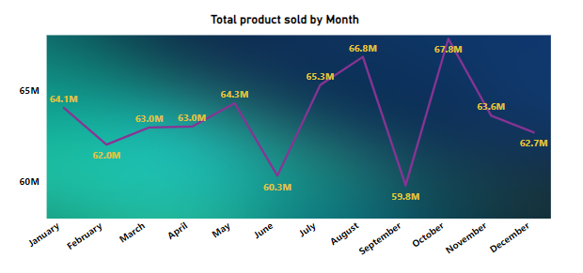
Model Development
Revenue trend by month
RFM analysis is used to determine which customers a business should target to increase its revenue and value.
The RFM (Recency, Frequency, and Monetary) model shows customers that have displayed high levels of engagement with the business in the three categories mentioned.

Slide 11
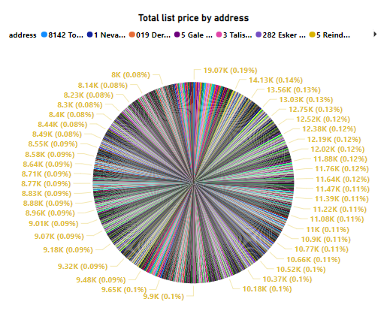
Data Exploration
Total price list by Address
RFM analysis is used to determine which customers a business should target to increase its revenue and value.
.

Slide 12
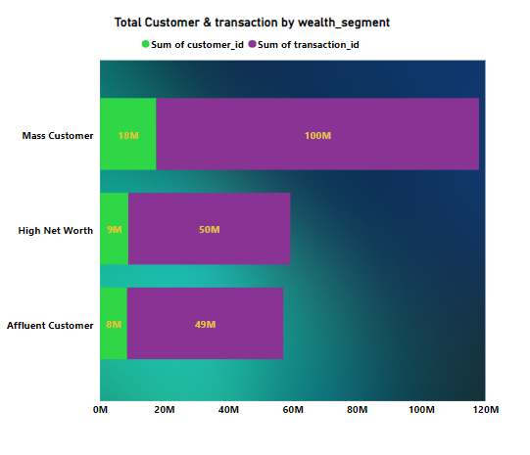
Data Exploration
Total customer & transaction
By wealth segment:
RFM analysis is used to determine which customers a business should target to increase its revenue and value.
.

Slide 13

By
yamuna

